Slide 1

Virtual Class Room
Presented By
Md. Shakib Hossain
ID: 16cseO31
Dept. of CSE, BSMRSTU
Supervised By
Tumpa Rani Shaha
Lecturer,
Dept. of CSE, BSMRSTU

Slide 2
Outlines
Introduction
Motivation
Objectives
Implementation
Conclusion
Future Work

Slide 3
INTRODUCTION
The main objective of the Virtual Class Room is to submit assignments and collect class equipment, sort exam, and store student details.
Its mainly developed for file sharing to submit Assignments in a fixed time and easy to communicate grow ability and gives remind alert notification. and have extra security with the messaging system.
Its stored users details with their photo. That’s why its easy to recognize. And save both question and answer paper of every student for review operation.
Its prevent from unwanted user to sign up and prevent unwanted access course after sign in.

Slide 4
MOTIVATION
Generally, in a traditional system, We can find attachment files of a particular class teacher with Bluetooth or keep them in google drive. And submit an assignment in a fixed time there is hardly any found without google classroom.
Improving study skill MCQ exam is play a vital rule.
Communicate with course teacher and class mate.
Publish automatically result after processing teacher answer sheet compare to student for grading and review to compare actual result
So combination of assignments upload, download Slides and giving Exam and communicate to classmate I have prepared this mobile application.

Slide 5
OBJECTIVES
To store assignments and class notes in fixed time with corresponding students and easy to search manipulate them.
To take class exam with MCQ for simple testing and publish automatically after finishing exam.
To communicate with course teacher and classmate in online.

Slide 6
Implementation
To sign up, User need to security key which is given by admin.
After successfully log in go to all courses and insert into one by given course security code and add to your courses.
All course need to course security code but my course don’t need to that
Green indicator allows submit and join in exam else these are disabled automatically in this application

Slide 7
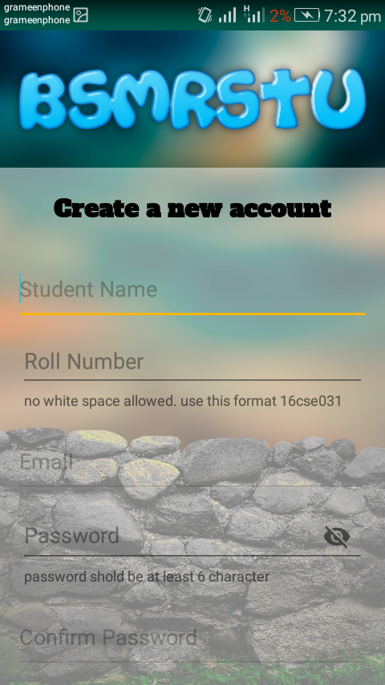
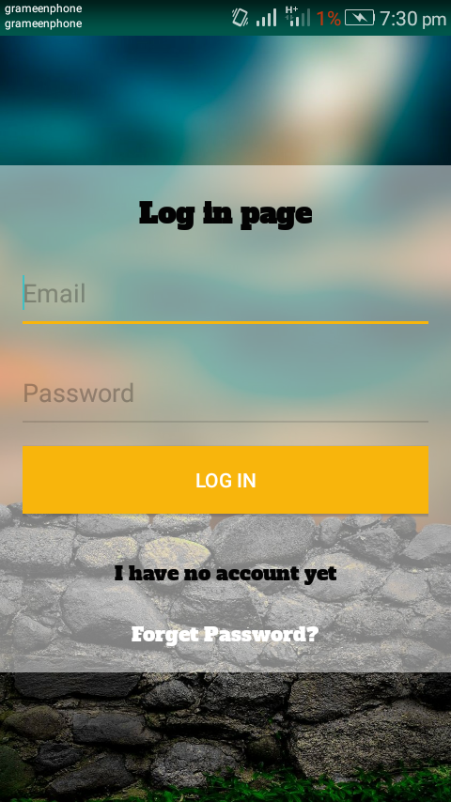
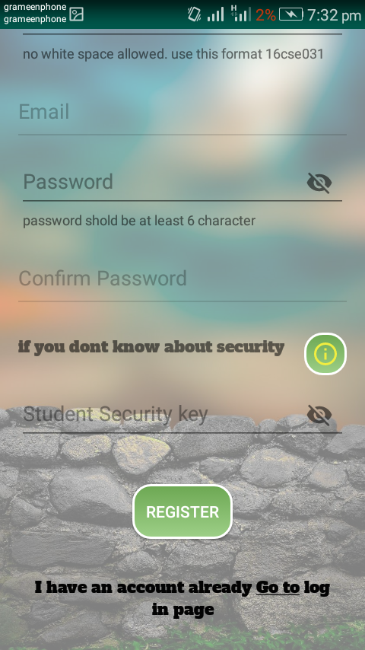
Registration

Slide 8
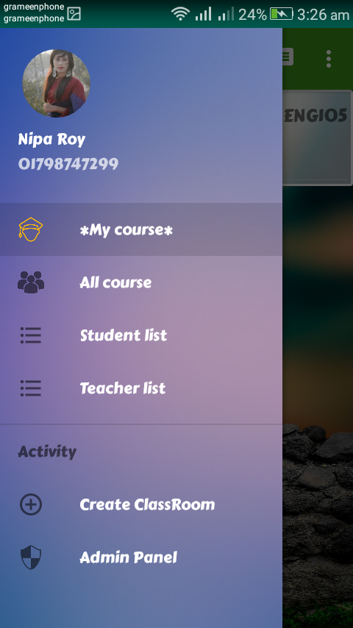
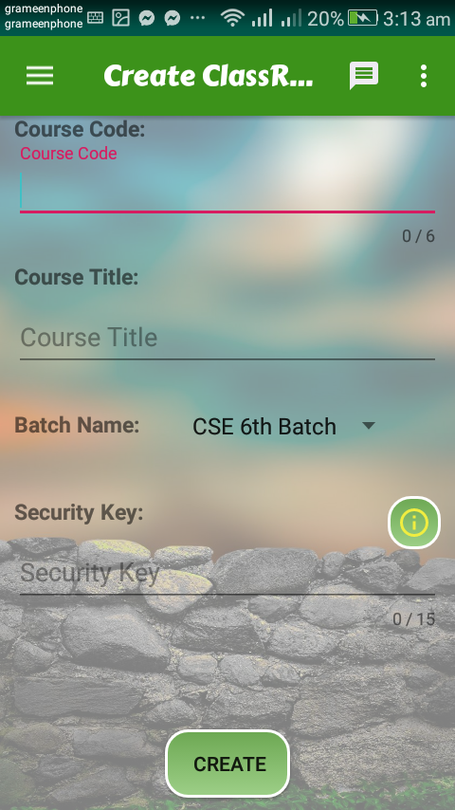
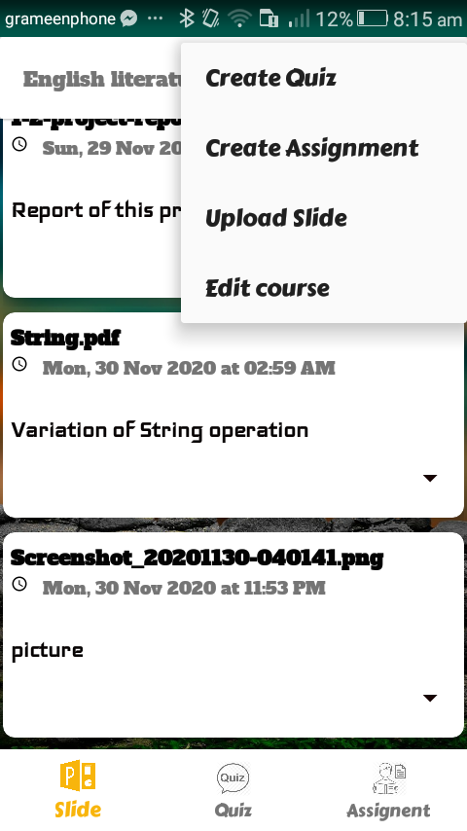
Create Class Room

Slide 9
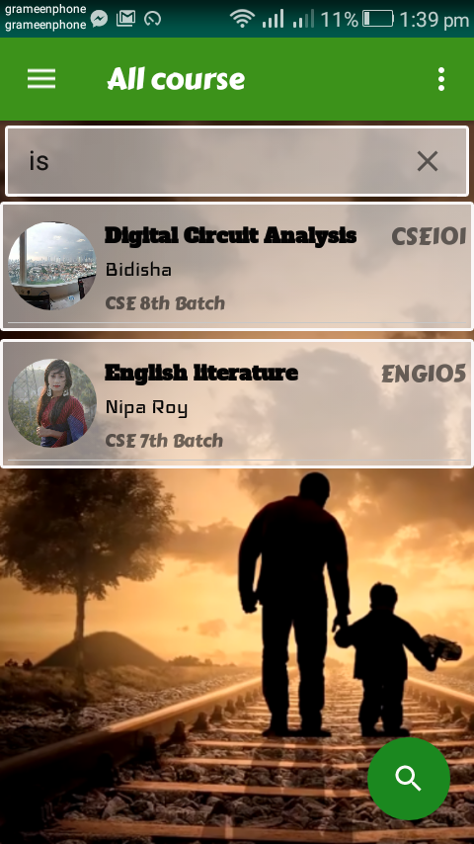
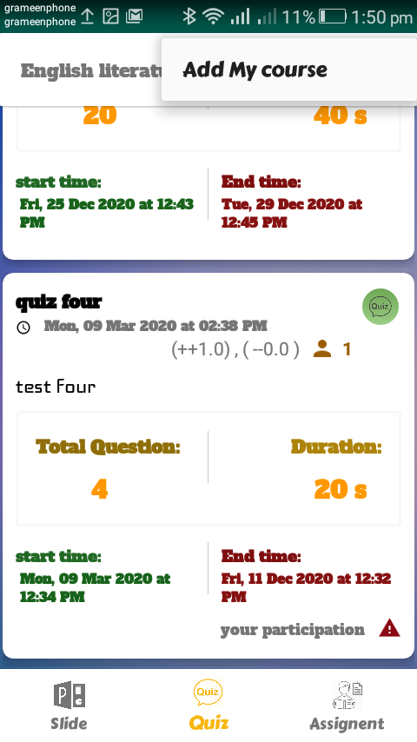

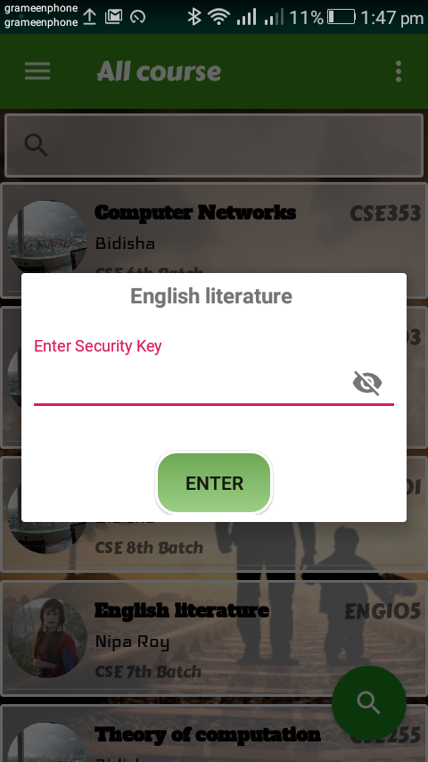
Home page
Click on
Course security
Click on
Added to my course

Slide 10
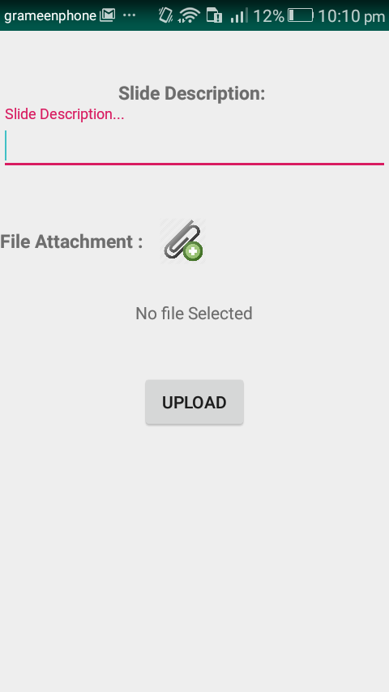
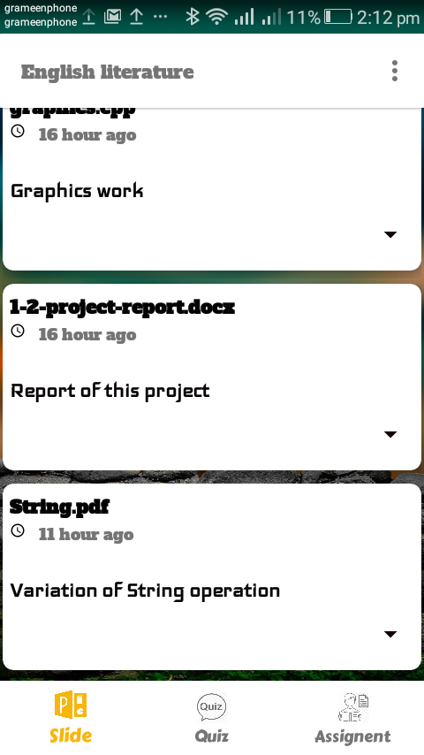
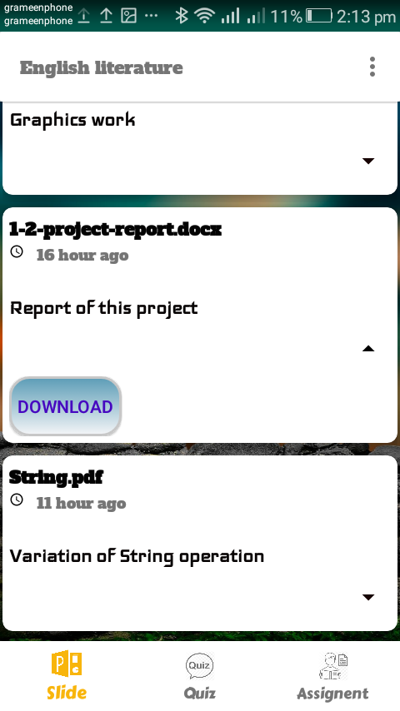
Slide content analysis
Download class note

Slide 11
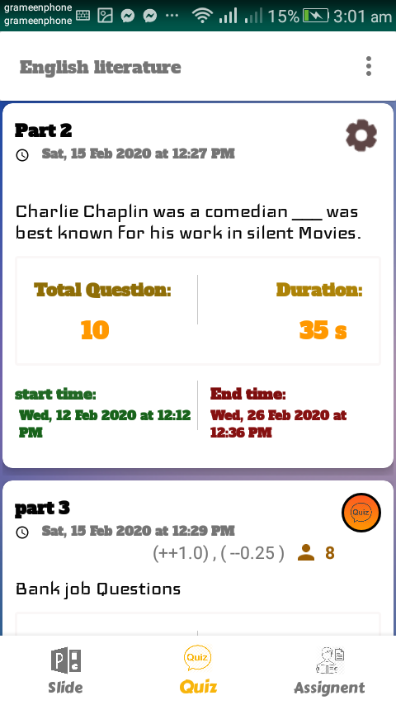
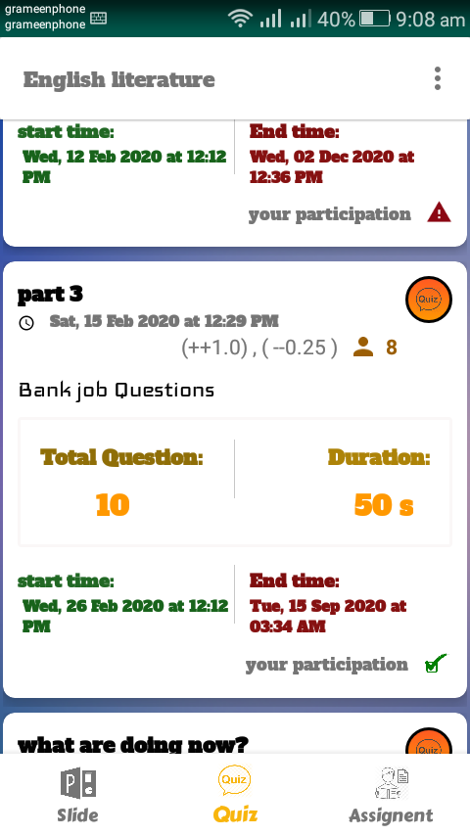
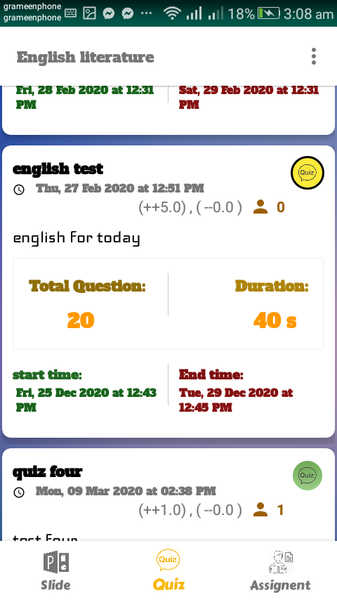
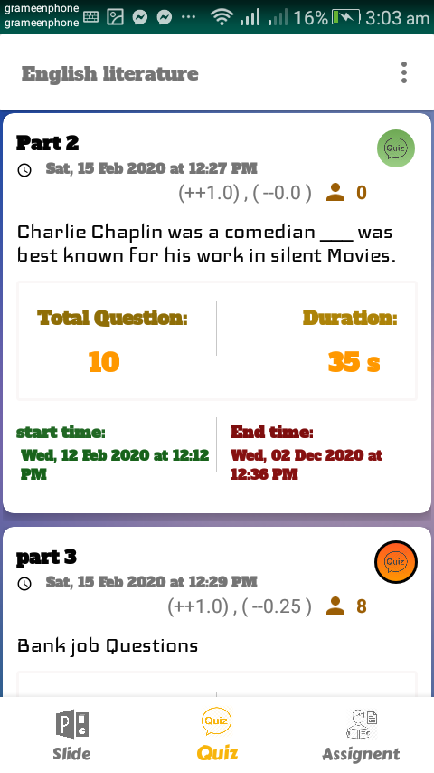
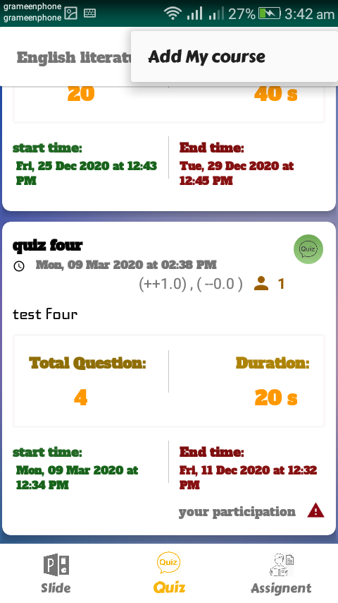
Quiz content front analysis
Total number of participating students
Increase mark
decrease mark
Final set Button
Title of content
Before starting Exam period
Publish date
Exam period
Content Details
After ending Exam period
Exam starting time
Exam finishing time

Slide 12
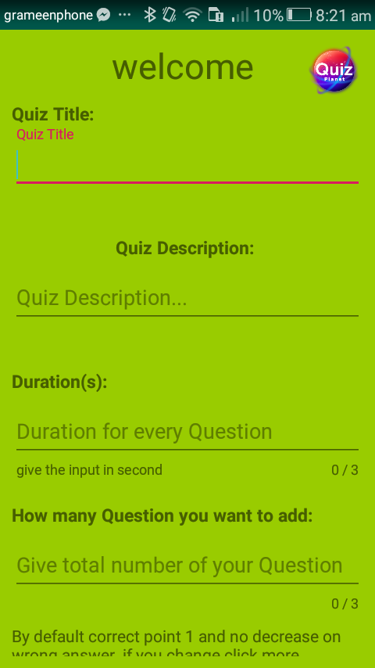
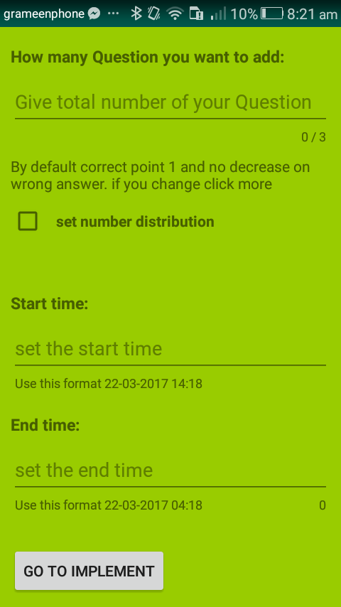
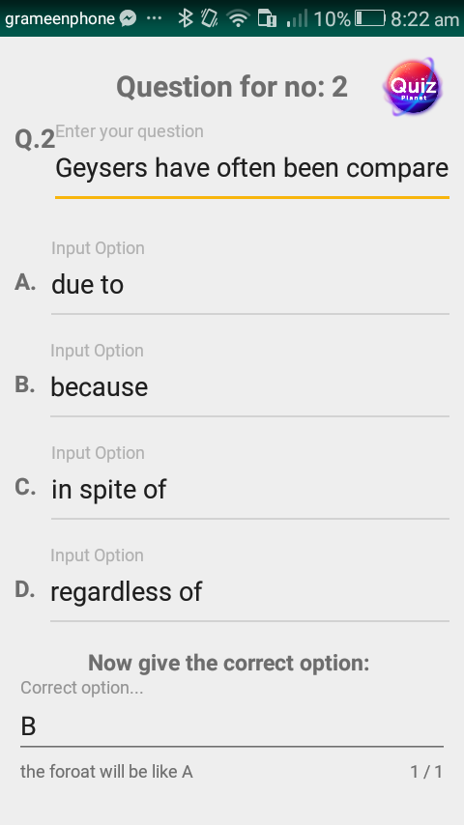
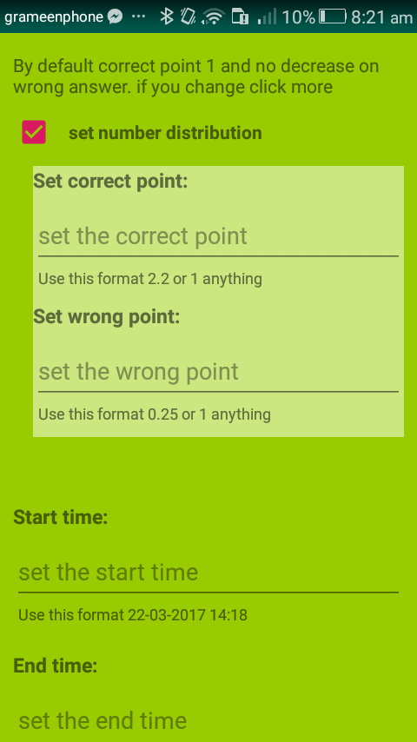
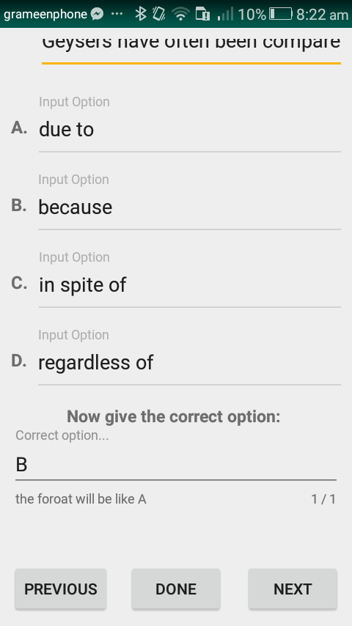
Quiz implement and add details

Slide 13
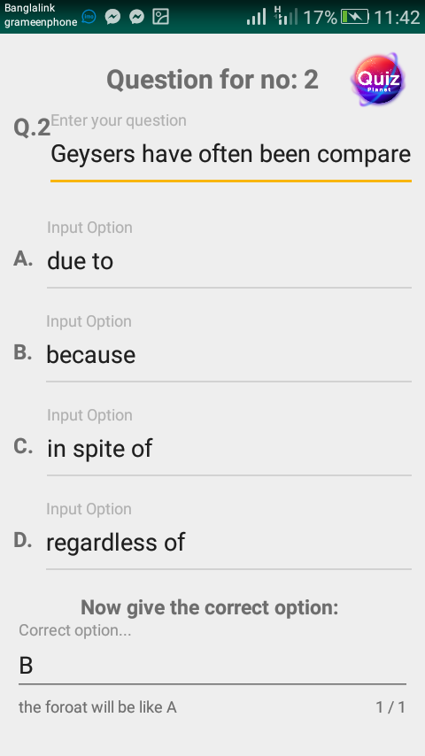
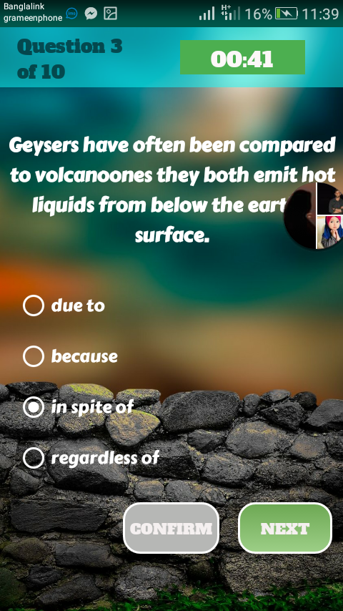
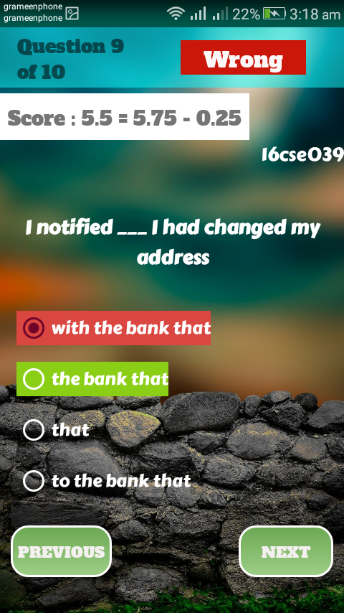
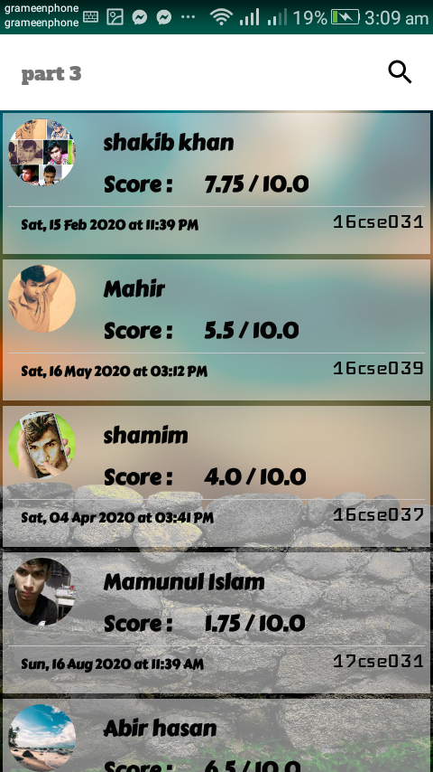
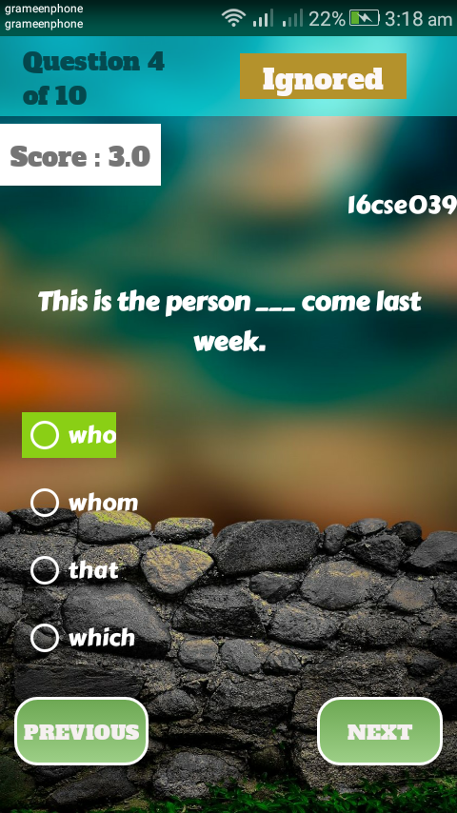
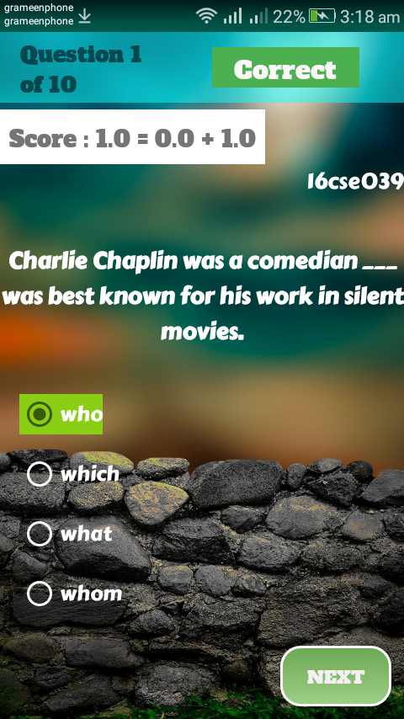
Teacher implement
Exam period
Result sheet
calculation
Review part

Slide 14
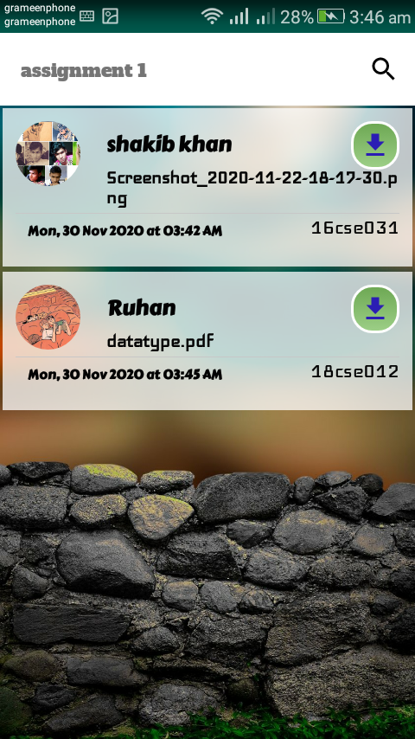
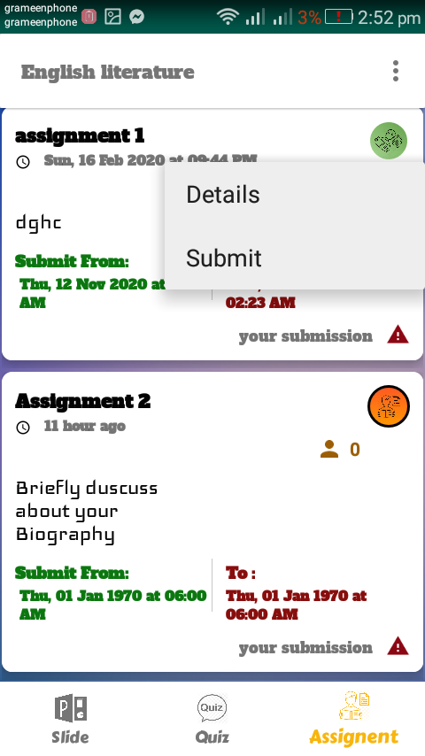
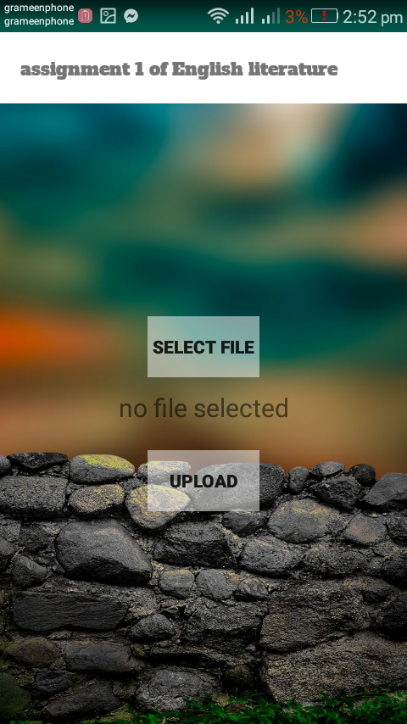
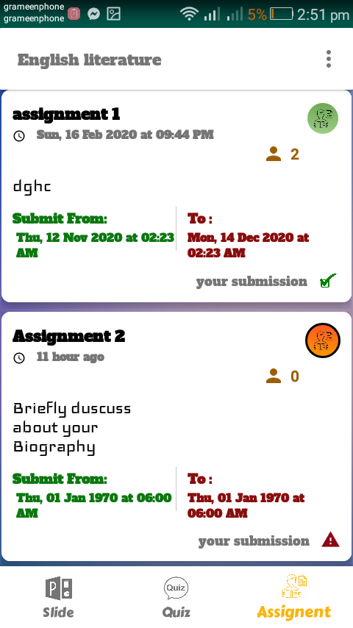
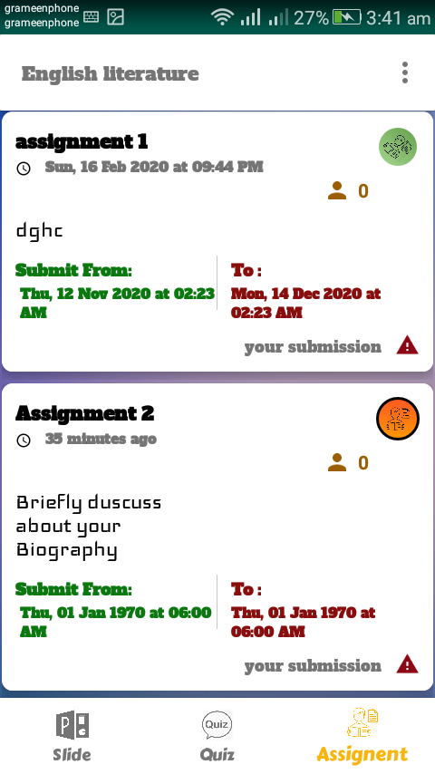
Assignment content

Slide 15
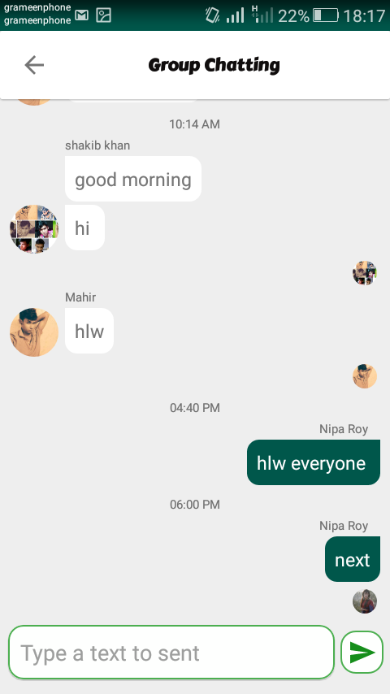
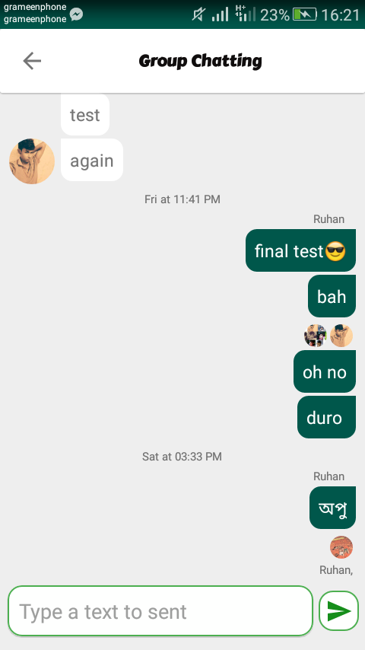
Group chat
Others Text message
Last viewer
Your Text message
Sender name
Send button

Slide 16
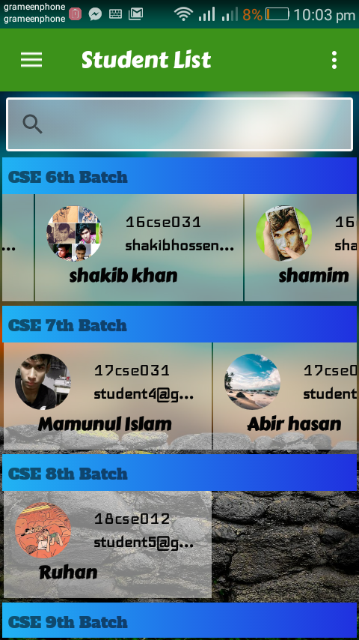
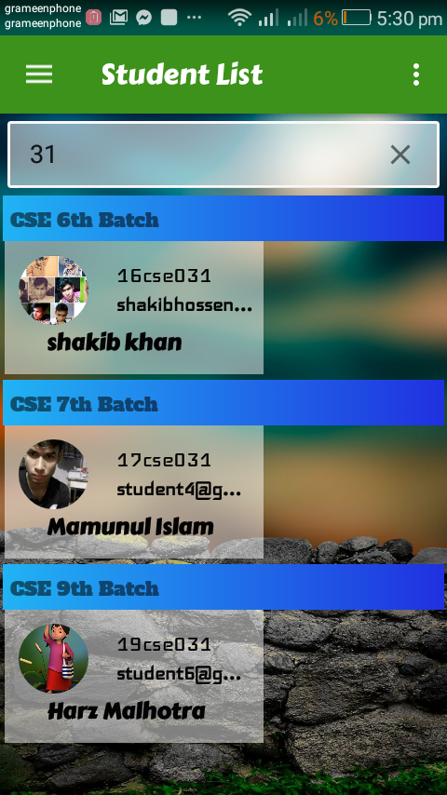

Student List

Slide 17
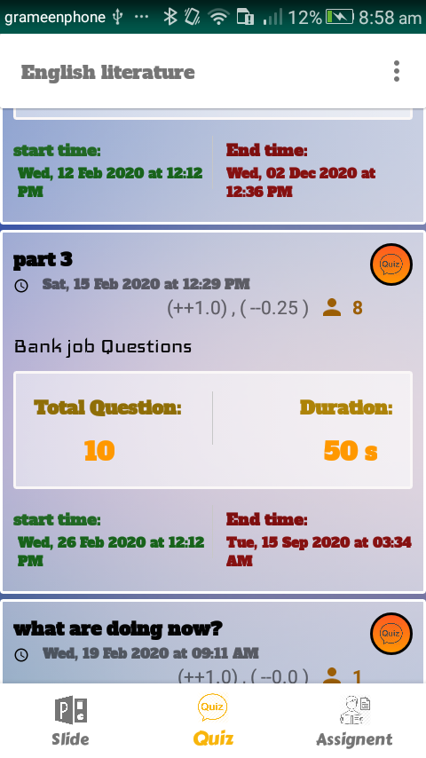
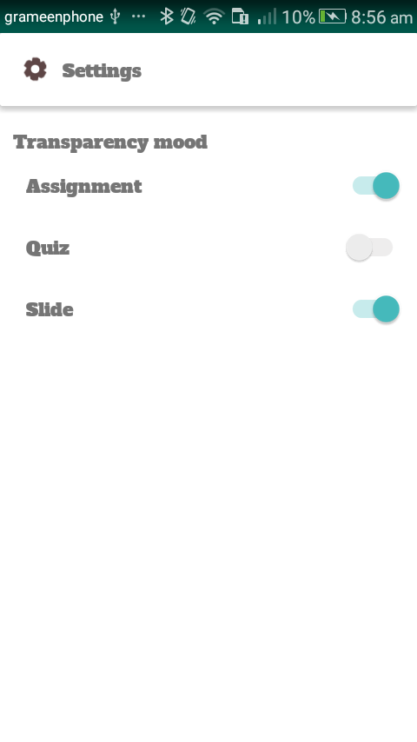
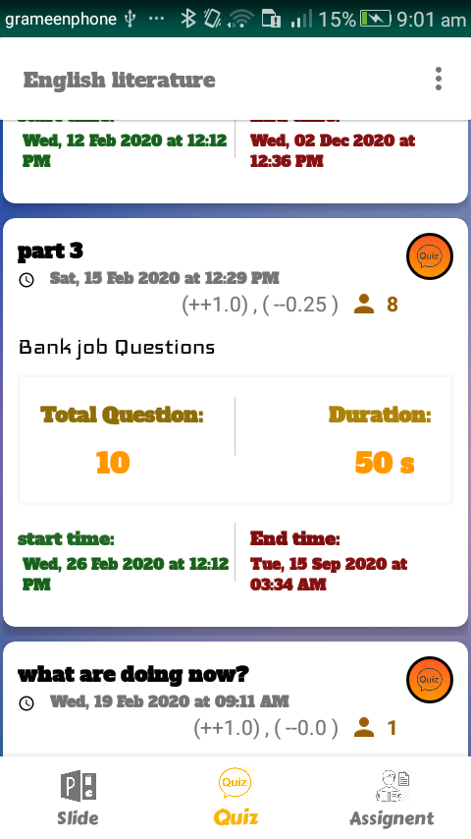
Setting
Transparency mood ON
Transparency mood OFF

Slide 18
CONCLUSION
Async task thread helper, Convert data from the millisecond, handle uploading, delete many documents in a while, reduce storage consumption, and many more.
After all, This project gives me precious experience in android development.
Understanding how the development should be carried out and the things that can go wrong in the development process is more important to develop an Application.
I assured that this application will make easier to share file and show the ability of study by giving MCQ exam and it ensures an end period of submitting the assignment.

Slide 19
FUTURE WORK
Develop a Smooth notification and when pressing on it, it brings you to the corresponding course or activity instance of Application default page.
Each question has a different option to choose positive and negative marks instance remains the same.
Add advanced options with pause resume to handle download more efficient manner.

Slide 20
Thank you

